Slide 1
Data Science Training Logistic Regression
Oct 5th 2016

Slide 2
Machine Learning
Today we look at Binary Classification using,
Logistic Regression.
See the book on Box or free online An Introduction to Statistical Learning, with Applications in R. Gareth James, Daniela Witten, Trevor Hastie and Robert Tibshirani

Slide 3
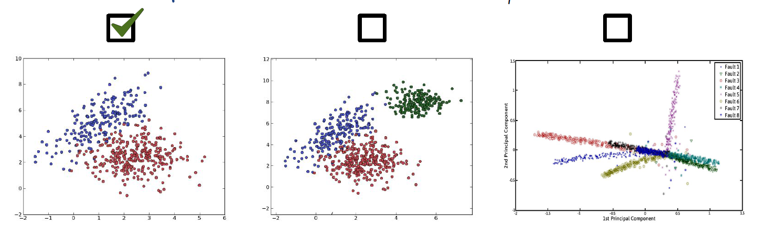
Binary Classification
Spam detection
Credit Card Fault
Attrition
Medical Diagnosis
… etc.
x
x

Slide 4
Linear Classifiers
Easy to train
Very fast prediction time. (the heavy lifting is in the training)
Well understood theory
Work well in high dimensions (thousand or millions of columns)

Slide 5
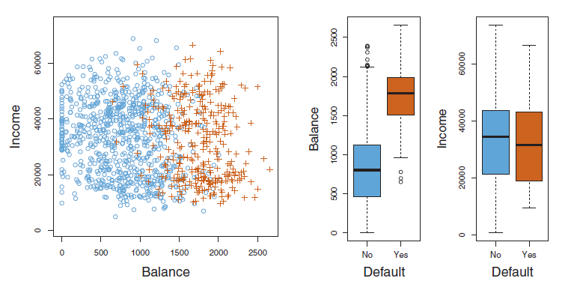
How to predict classes

Slide 6
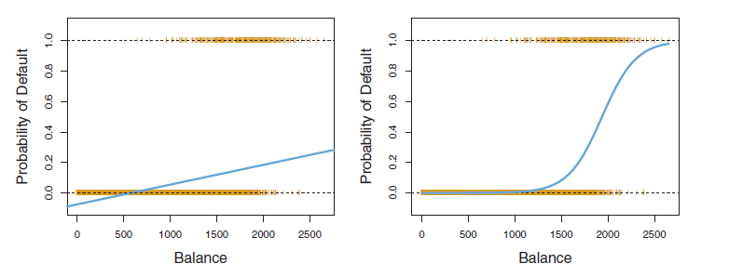
Classification – Linear vs. Logistic Regression
Model Probability of default
Default
No Default
Linear Regression
Logistic Regression

Slide 7
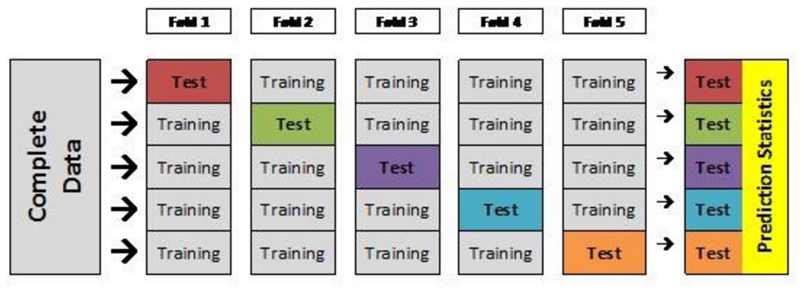
Cross Validation

Slide 8
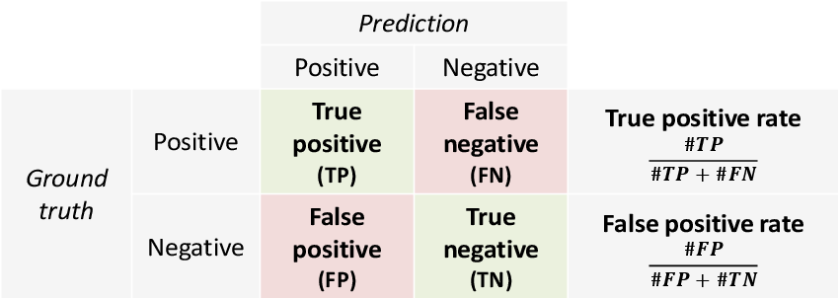
Contingency Table
Not all errors are the same….
Spam detection… reducing FP is priority
Cancer diagnosis … reducing FN is priority

Slide 9
Thank you!

